Slide 1


Department Of Computer Science

Slide 2
Final Report Project Title (Valid Title, reflecting scope and objectives)
Student 1 Name
Student 1 Registration Number.
Student 2 Name
Student 2 Registration Number.
Supervisor:
Supervisor Name
Department Of Computer Science
Submission Date: Day-Month-Year

Slide 3
Project Category
Our system is a web application

Slide 4
Abstract
The proposed project “Save Food Stuff” is a web app through which a link is created between restaurants and charity homes/ needy people for food donation.
The targeted problems our app will be solving is distribution of extra food among the needy people. Only authentic charity homes and needy households would get registered and would get free food from restaurants.

Slide 5
Introduction
This project is primarily developed for the distribution of extra food from restaurants to different shelter homes in order to help poor and needy people and to avoid food wastage.
In last research, a drastic increase can be seen in wastage of food. As per data given by WHO, 20% of the population faces extreme food shortages.
Our project contributes in solving this problem.

Slide 6
Problem Statement
All over the world, more than enough food is produced to feed the world population. But still world hunger is on the rise affecting around 9.9 percent of the people globally.
Almost 811 million people go to bed hungry each night.
This number of world hunger can be reduced if the excess food that goes into waste is delivered to the needy people instead.
Our proposed system solves the problem of distribution of extra food so that this food is utilized instead of going in trash.
A few soft wares already exist but they lack checking whether the food is being delivered to authentic needy people or not.

Slide 7
Problem Statement
All over the world, more than enough food is produced to feed the world population. But still world hunger is on the rise affecting around 9.9 percent of the people globally.
Almost 811 million people go to bed hungry each night.
This number of world hunger can be reduced if the excess food that goes into waste is delivered to the needy people instead.
Our proposed system solves the problem of distribution of extra food so that this food is utilized instead of going in trash.
A few soft wares already exist but they lack checking whether the food is being delivered to authentic needy people or not.

Slide 8
Advantages/Benefits of Proposed System
Awareness and solution about the proper food donation will be spread.
Keep track of the extra food available at restaurants.
Poor and needy people will be able to get the food products which will prove to be lifesaving for them.
Both the restaurants (reducing food wastage) and the needy people will be helped.
Giving reviews will be helpful to monitor the overall app working and to enhance its features as well.

Slide 9
Related System Analysis/Literature Review
Application Name | Weakness | Proposed Project Solution
OLIO – Share more Waste less | Privacy Issues Everyone have access to open it and use it either for wrong or right intentions. | Provide proper security to its user. Makes sure that food only reaches the needy.
SWOT- Food Waste & Recovery | No centralized platform for accurate, actual and transparent data about wasted food in our region. Complexity makes it challenging to communicate clear messages to target audience and general community | Support for new and existing value added processors that can preserve wasted food. Less complex system.
Food Waste Management system | Does not require user registration. | Only registered user can log in.

Slide 10
Scope
After downloading the application new user have to register using their usernames and login details along with the document attachment for verification by the admin. [1]
After successful registration user will see multiple options which includes “Find Food” to search for the restaurant which offer food , “Setting” Option have its own multiple sub options to help the user and “Reviews” area help to get the reviews from the user.
If someone want to donate something he/she can easily donate by using “Donate” option on the front login screen.

Slide 11
Modules
Module 1: Login and registration
Module 2: Donation
Module 3: Settings
Module 4: Find food
Module 5: Delivery
Module 6: Admin
Module 7: Reviews
Module 8: Restaurant module

Slide 12
Module-1: Login and Registration
This module is used to login or getting yourself registered in the app.
MF 1.1 Login:
Login would be done by using username and password.
MF 1.2 Sign up:
User will sign up by income/expenses verification.
MF 1.3 Change Password:
After authenticating, user can change its password

Slide 13
Module-2: Donation
On the same page of login, there is a donation menu where anyone can donate as much as they want to whatever restaurant/charity home they like.
MF 1.1 Donation to restaurants:
In this option, list of all the restaurants will be mentioned.
MF 1.2 Donation to Charity homes/ needy households:
A list of all the registered charity homes/ needy households is mentioned.

Slide 14
Module-3: Settings
In the settings menu, different options are available
MF 3.1 How to use?
In this option, user will get complete guidance on how to use this app.
MF 3.2 Profile management
User can change its user name, email and phone number.
MF 3.3 Logout
Use can logout form the app.
MF 3.4 User history
User can view its history of the order received/dispatched.

Slide 15
Module-4: Find Food
In this menu, all the restaurants in the nearby locality will be mentioned that currently have food available.
This restaurant list is based on reviews priority. Restaurants with higher reviews will be on the top. After selecting the restaurant, user can request food per person. This request will also be accepted based on priority.

Slide 16
Module-5: Delivery
In this module, the requested food will be delivered by the restaurant to the requester with very les delivery charges. Moreover, the requester will also be given an option that if it can pay at least 10 to 15% for the food, it can do so. Otherwise food will be delivered for free.

Slide 17
Module-6: Admin
The admin will be given following options:
MF 6.1 Active Restaurants/ Members
Admin can view all restaurants and members that are currently serving the food to the needy and deserving people. All the restaurant’s and user’s activity will displayed to the admin from here.
MF 6.2 Send Notification:
Admin also have the authority of sending notification on successfully creating user’s account after document validation.
MF 6.3 Requests
Admin will give rankings from 1-10 based on average document provided by the user that will tell whether the member is less or more deserving. On these basis admin will accepts the requests of the user that has currently received.
MF 6.4 View Rating:
Admin can view the ratings of all the restaurants that are serving to both needy and shelter homes.

Slide 18
Module-7: Reviews
On the front page, with find food and settings, reviews option is also given where a member will give reviews to restaurants that boost that restaurant to top of the list of the restaurants that can be given donations.

Slide 19
Module-8: Restaurants module
In restaurant’s profile, they can add the amount of food they have (per person) and they can accept requests based on the priority basis. The members with higher ranking (i.e. more deserving) would be accepted first.

Slide 20
System Limitations/Constraints
If server is down it will not work effectively.
Proper connectivity of the internet effect it’s working.
Both parties need to have proper internet connection.
As a lot of requests will reach to admin for verification and it is possible that admin may approve all of them without proper verification this will cause less deserving people also getting registered.

Slide 21
Software Process Methodology
Process Methodology
Different process models have been identified for designing software which includes Waterfall/Modified Waterfall model, V-Shaped model, Evolutionary process model as well. But here V-shaped Process Model will be adopted in our project because the testing and production of features will going side by side.
Design Methodology
Object Oriented approach will be used as the Design Methodology. Changes can be easily done in the Object Oriented, some basic concepts which are useful to this methodology which includes Inheritance, Polymorphism, Composition, Aggregation and reusability of code. These are helpful during implementation of designed software.

Slide 22
Tools and Technologies
Tools And Technologies | Tools | Version | Rationale
 | MS Visual Studio | 2015 | IDE
 | MS SQL Server | 2015 | DBMS
 | MS Visio | 2016 | Design Diagrams
 | MS Word | 2015 | Documentation
 | MS Power Point | 2015 | Presentation
 | Pencil | 2.0.5 | Mockups Creation
 | Technology | Version | Rationale
 | Java | 6.0 | Programming language
 | SQL | 2013 | Query Language
 | Html&CSS | 5 | Web Development

Slide 23
Project Stakeholders and Roles
Project Sponsor | COMSATS, Institute of Information Technology Islamabad
Stakeholder | Students names Kainat Mudassar Maha Farooqi Project Supervisor Name: Mr. Tahseen Riaz Abbasi Final Year Project Committee: Evaluation of project

Slide 24
Data Gathering Approach
Below are main methodologies that will be used for Data Gathering.
Documents and Records will be seen to gather more information.
Questionnaires will be the main source of gathering requirements.
Meeting with Restaurants & Charity homes also important to make sure that our requirements are accurate and to avoid errors as well.

Slide 25
Concepts
There are two basic concept that we have learnt to develop our application which includes:
API Injection:
APIs are predefined functions that can be used according to our requirements instead of writing the whole code. It works as a messenger that takes requests and tells the system what you want to do and then returns the response back. All interactions between data and devices are done through APIs.
Database CRUD operations:
All the members and restaurants information and records will be saved in a database.

Slide 26
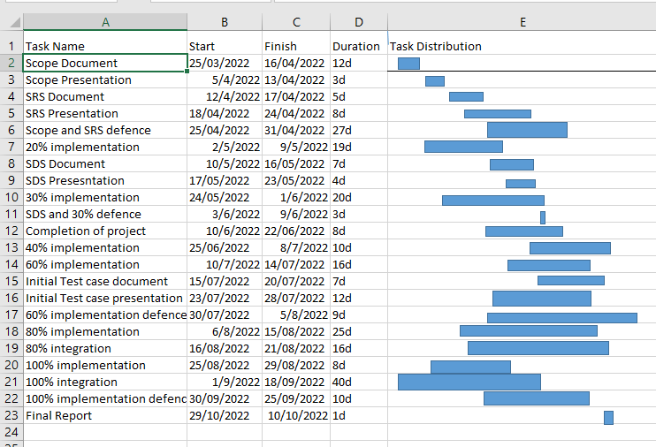
Gantt Chart
Grant Chart and provide estimated start and end dates of all proposed modules/tasks for each team member is shown below.

Slide 27
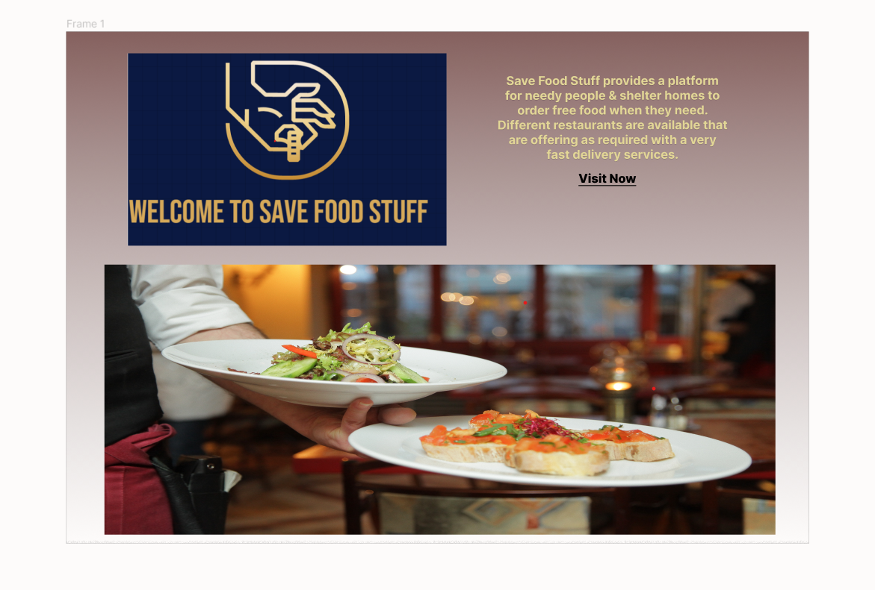
Mockups
Main Home Page of Application.

Slide 28
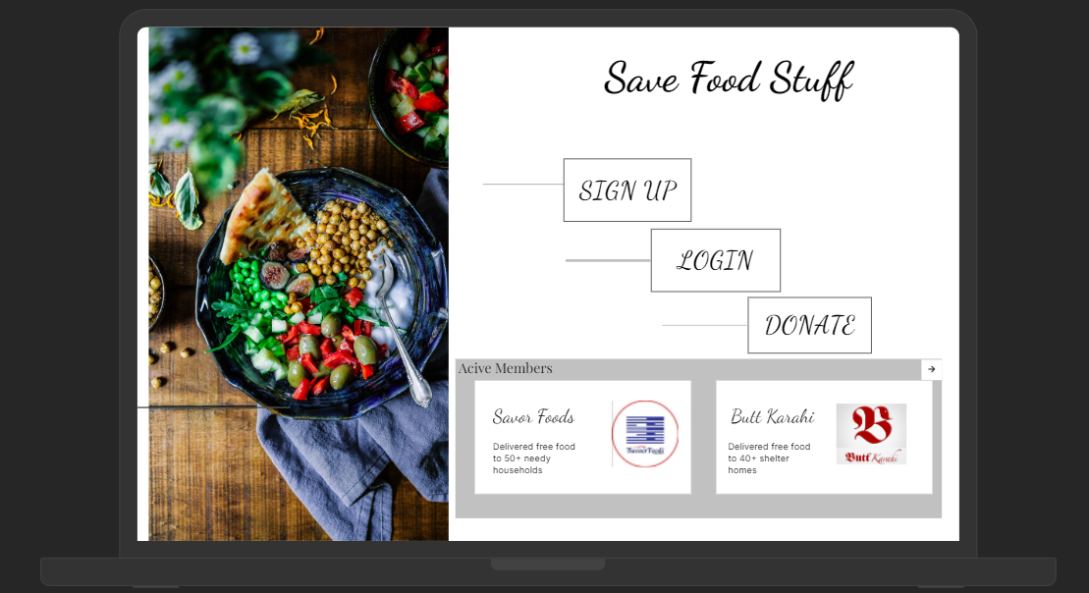
Mockups
Login Page.

Slide 29
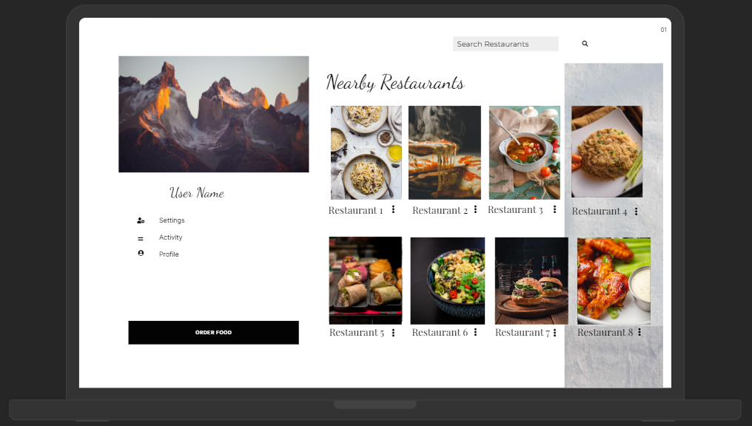
Mockups
Find Food Page For User.

Slide 30
SRS

Slide 31
Requirement Elicitation Techniques

Slide 32
List of Use Cases Module Wise Module-1: Module Name
(Hyper Link for Tabular Use Cases)
Use Case Id | Use Case Title | Use Case Description | Functional Requirement
UC-1 | Admin | Admin will manage the major activities of whole System | Hyper Link the FR Of this use case.
UC-2 | Restaurant | Restaurant control the food to be order per person and out for delivery | Hyper Link the FR Of this use case.
UC-3 | User | User have the access to find food, search restaurants and other functionality as well | Hyper Link the FR Of this use case.
UC-4 | Delivery Boy | Delivery boy have to deliver the ordered food to the receiver. | Hyper Link the FR Of this use case.
UC-5 | Donor | If someone wants to donate something other than food it can easily be done from here. | Hyper Link the FR Of this use case.

Slide 33
Non-Functional Requirement
Non Functional Requirements are:
Title |  | Performance Requirements
NFR-1 |  | Loading time page of any website should not exceed from 5 seconds on DSL broadband connection. No of user using the system and internet speed are the main factors that involves in it’s working. The application should be able to support 100 concurrent users without any performance degradation. The website should have a refresh timer of almost 10 seconds.
Title |  | Reliability
NFR-2 |  | The system will be available on all time as availability is 24/7. So a user can access the website anytime. In the event that a server does down, the server will kick in inside an opportunity that the application doesn’t quit running. In case of a future that lead to a system outrage, the MTTR (Mean Time to Repair) should not be more than 2 hours.
Title |  | Usability
NFR-3 |  | 96% or the users will complete their task without any assistance. Interface of our designed system should be user friendly. If a new user is registering an account than it should not take more than 10 seconds to complete his/her request. User will have a self-explanatory interface to perform required task.
Title |  | Supportability
NFR-4 |  | The web application should support Google Chrome, Internet explorer, Opera and Mozilla Firefox web browsers. The framework should be cost effective.

Slide 34
Use Case Diagrams
Note: 1 Slide/Per Diagram (Usually 2-5 Slides)
Insert Use Case Diagrams as per Actors wise and with proper labeling and caption.
Usually (2- diagrams)
Create Use Case Diagram Using MS VISIO (or any other standard UML supported Tool) as per UML standard notations.

Slide 35
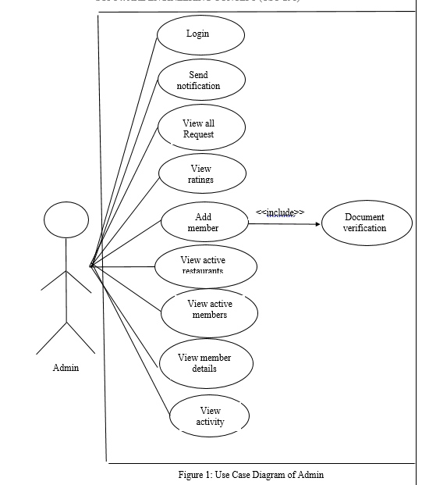
Use Case Diagram

Slide 36
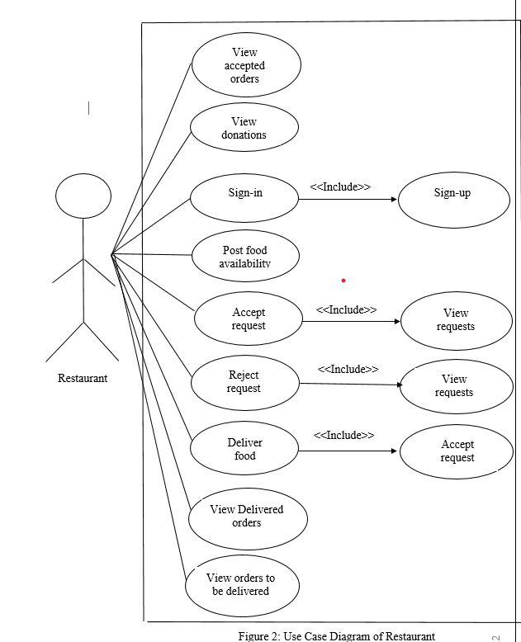
Use Case Diagram

Slide 37
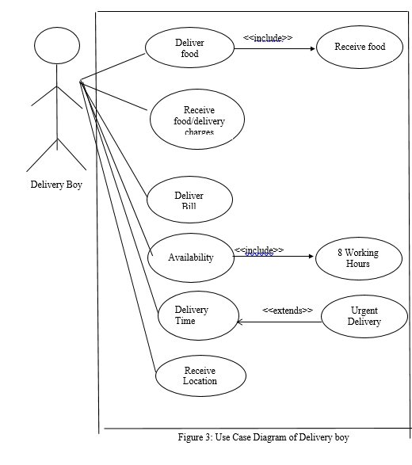
Use Case Diagram

Slide 38
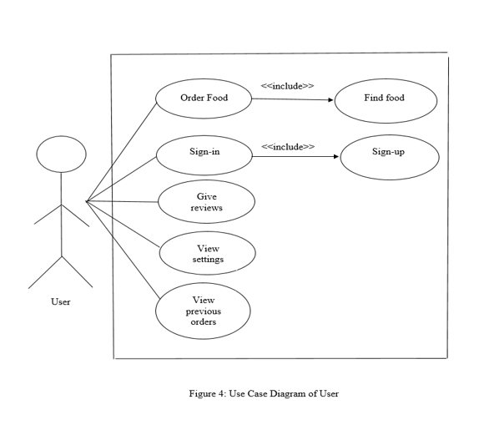
Use Case Diagram

Slide 39
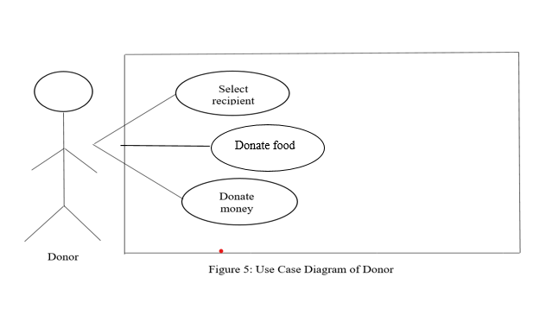
Use Case Diagram

Slide 40
SDS

Slide 41
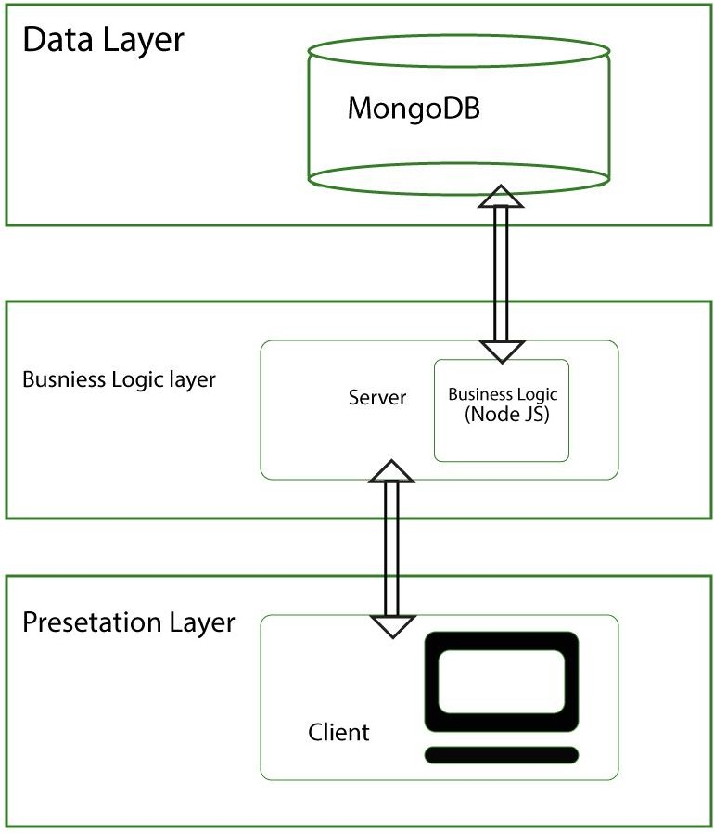
Architecture Diagram of Proposed Project
SQL
Business Logic (Java)
Figure-2: 3 tier Architecture Diagram

Slide 42
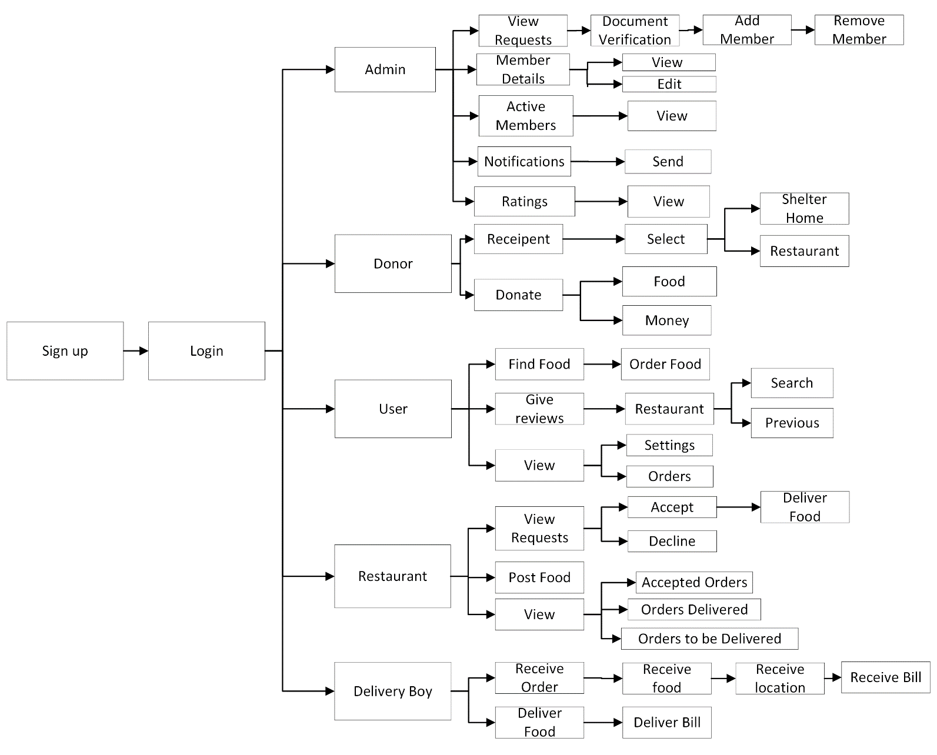
Block Diagram of Proposed Project
Figure-1: Block Diagram of Save Food Stuff.

Slide 43
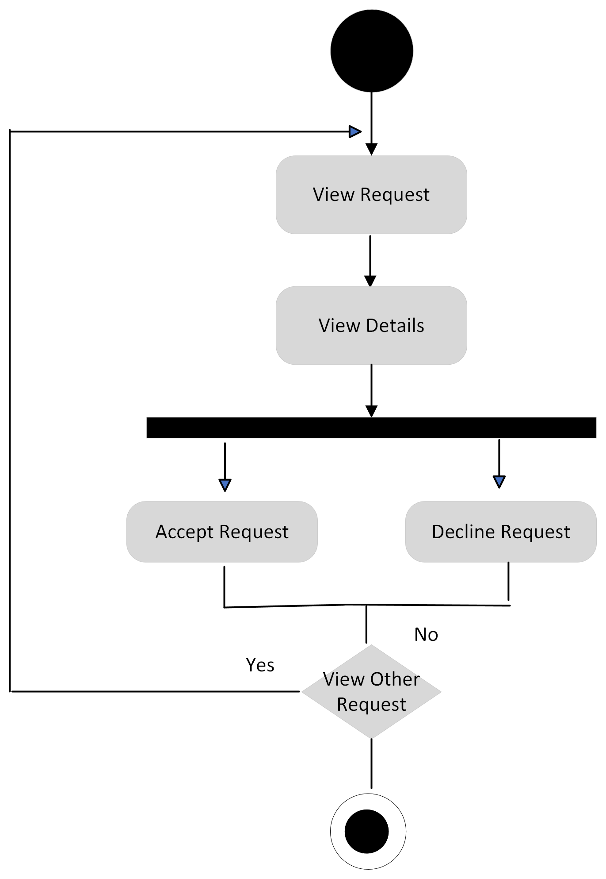
Activity Diagrams
Figure: Activity diagram of “Add Member”

Slide 44
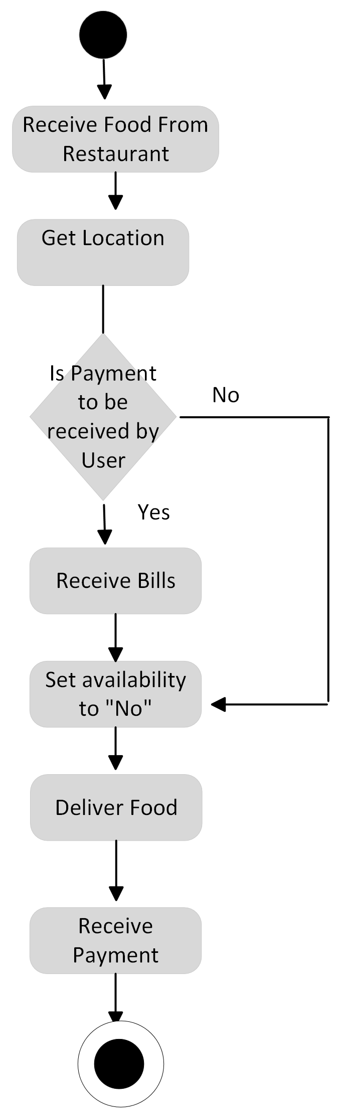
Activity Diagrams
Figure: Activity diagram of “Delivery Boy”

Slide 45
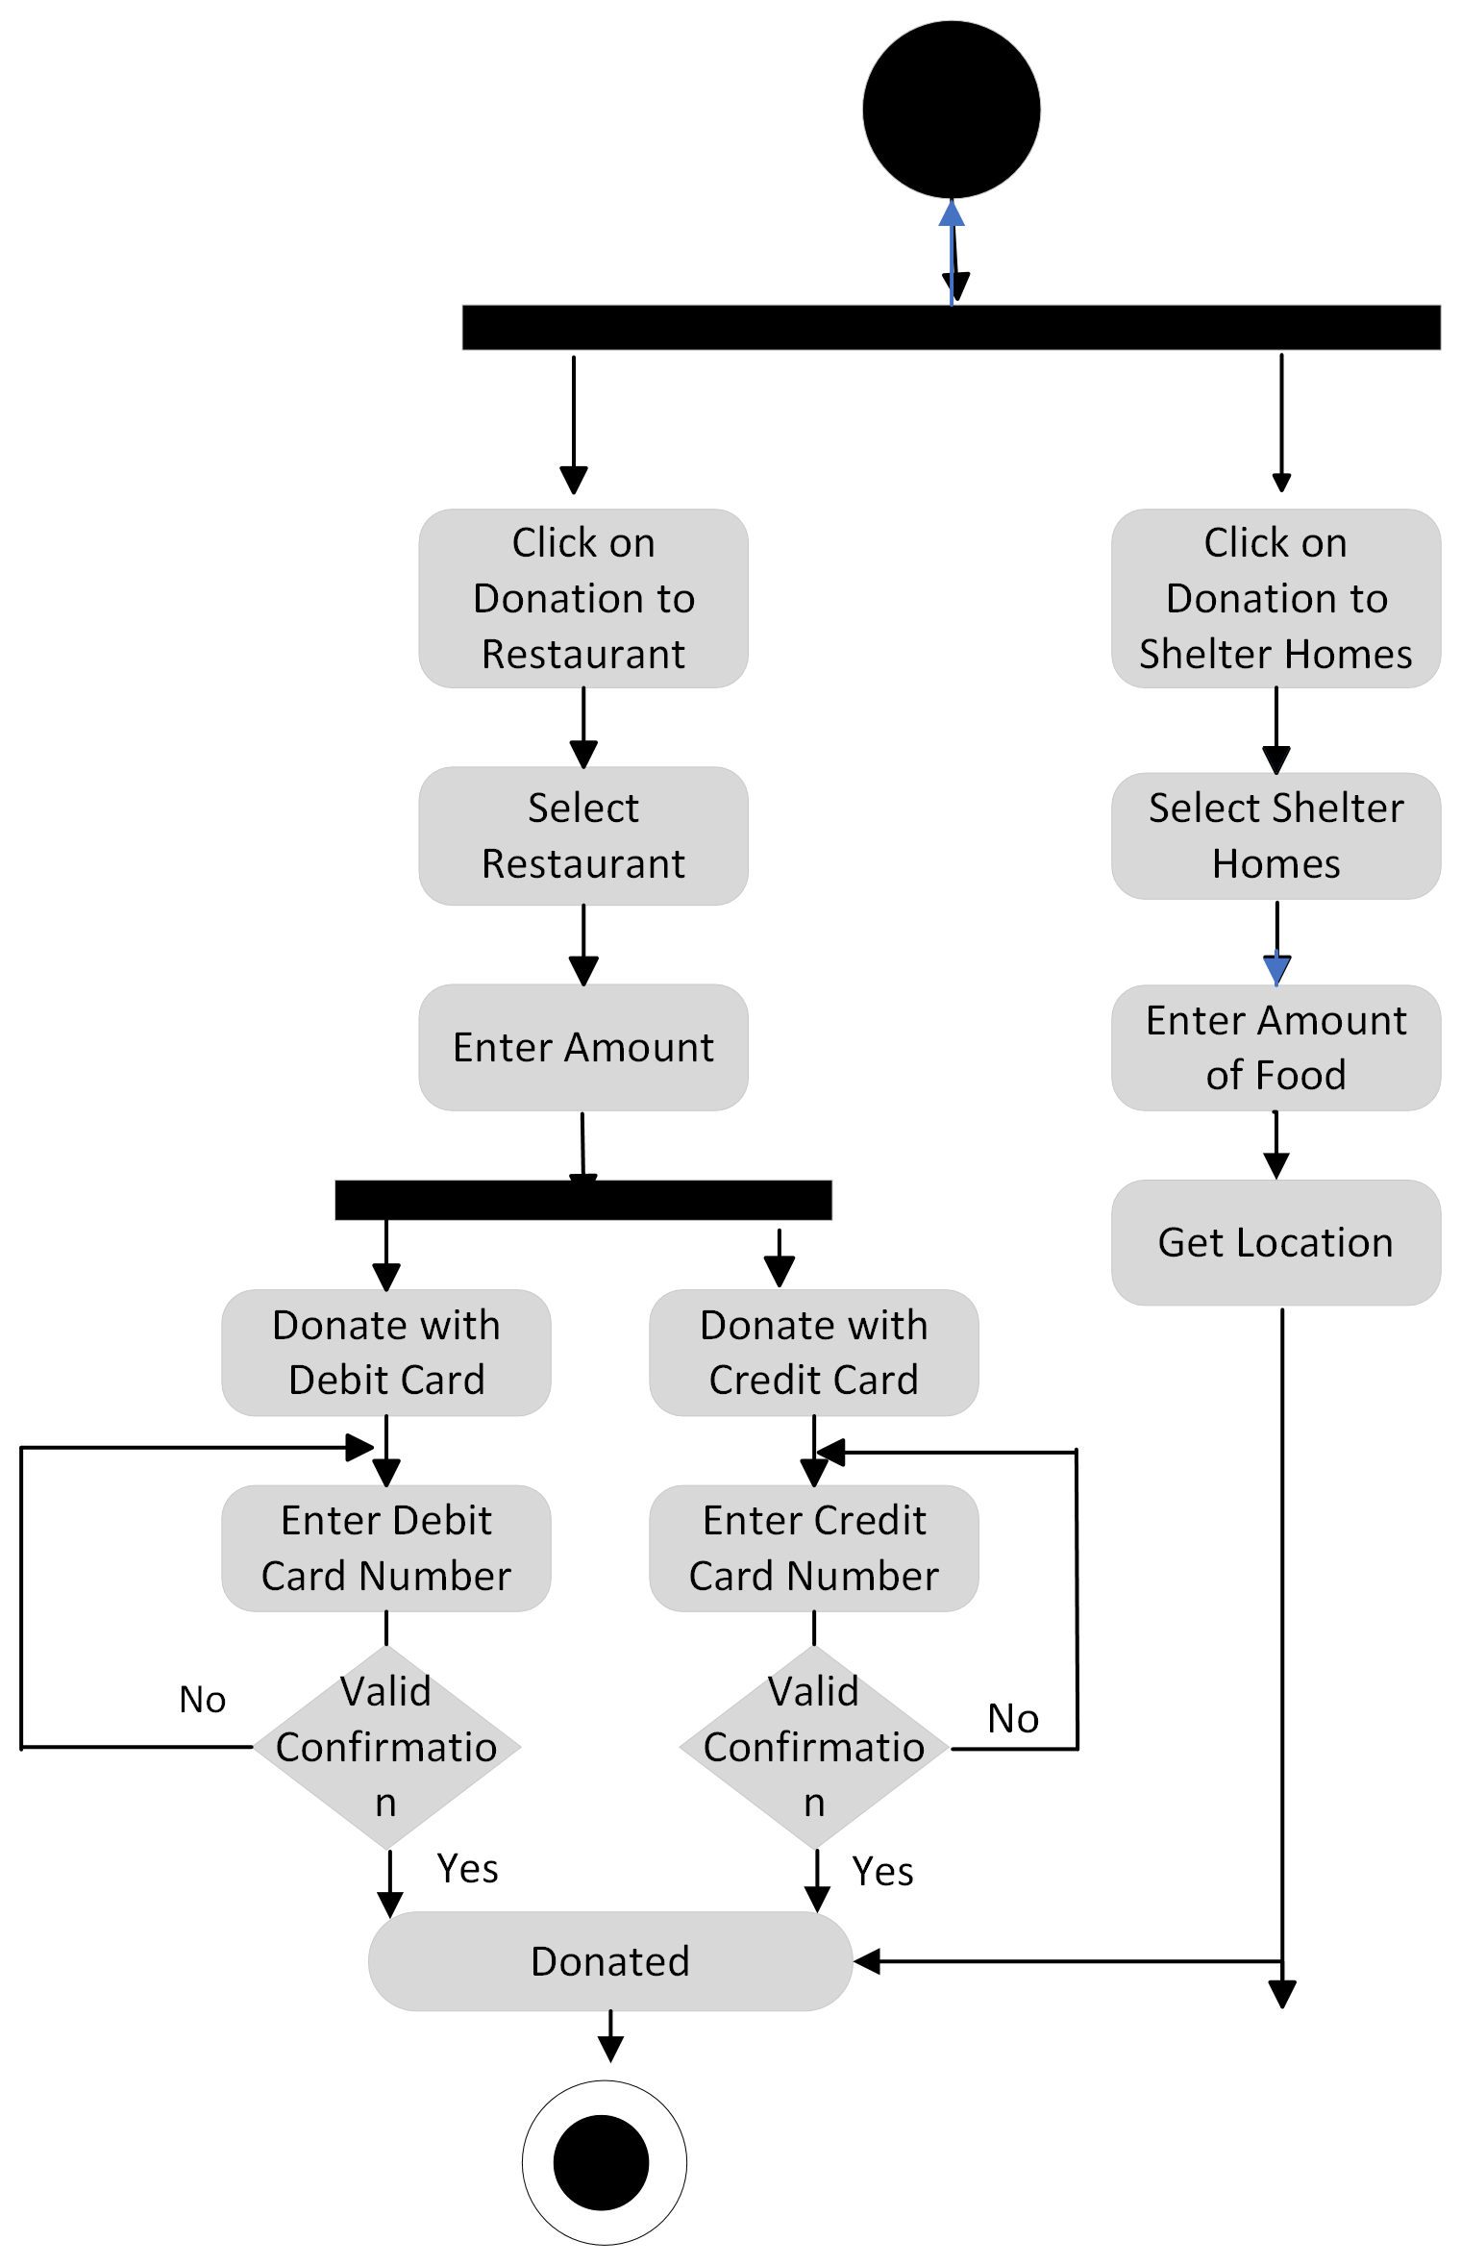
Activity Diagrams
Figure: Activity diagram of “Donation”

Slide 46
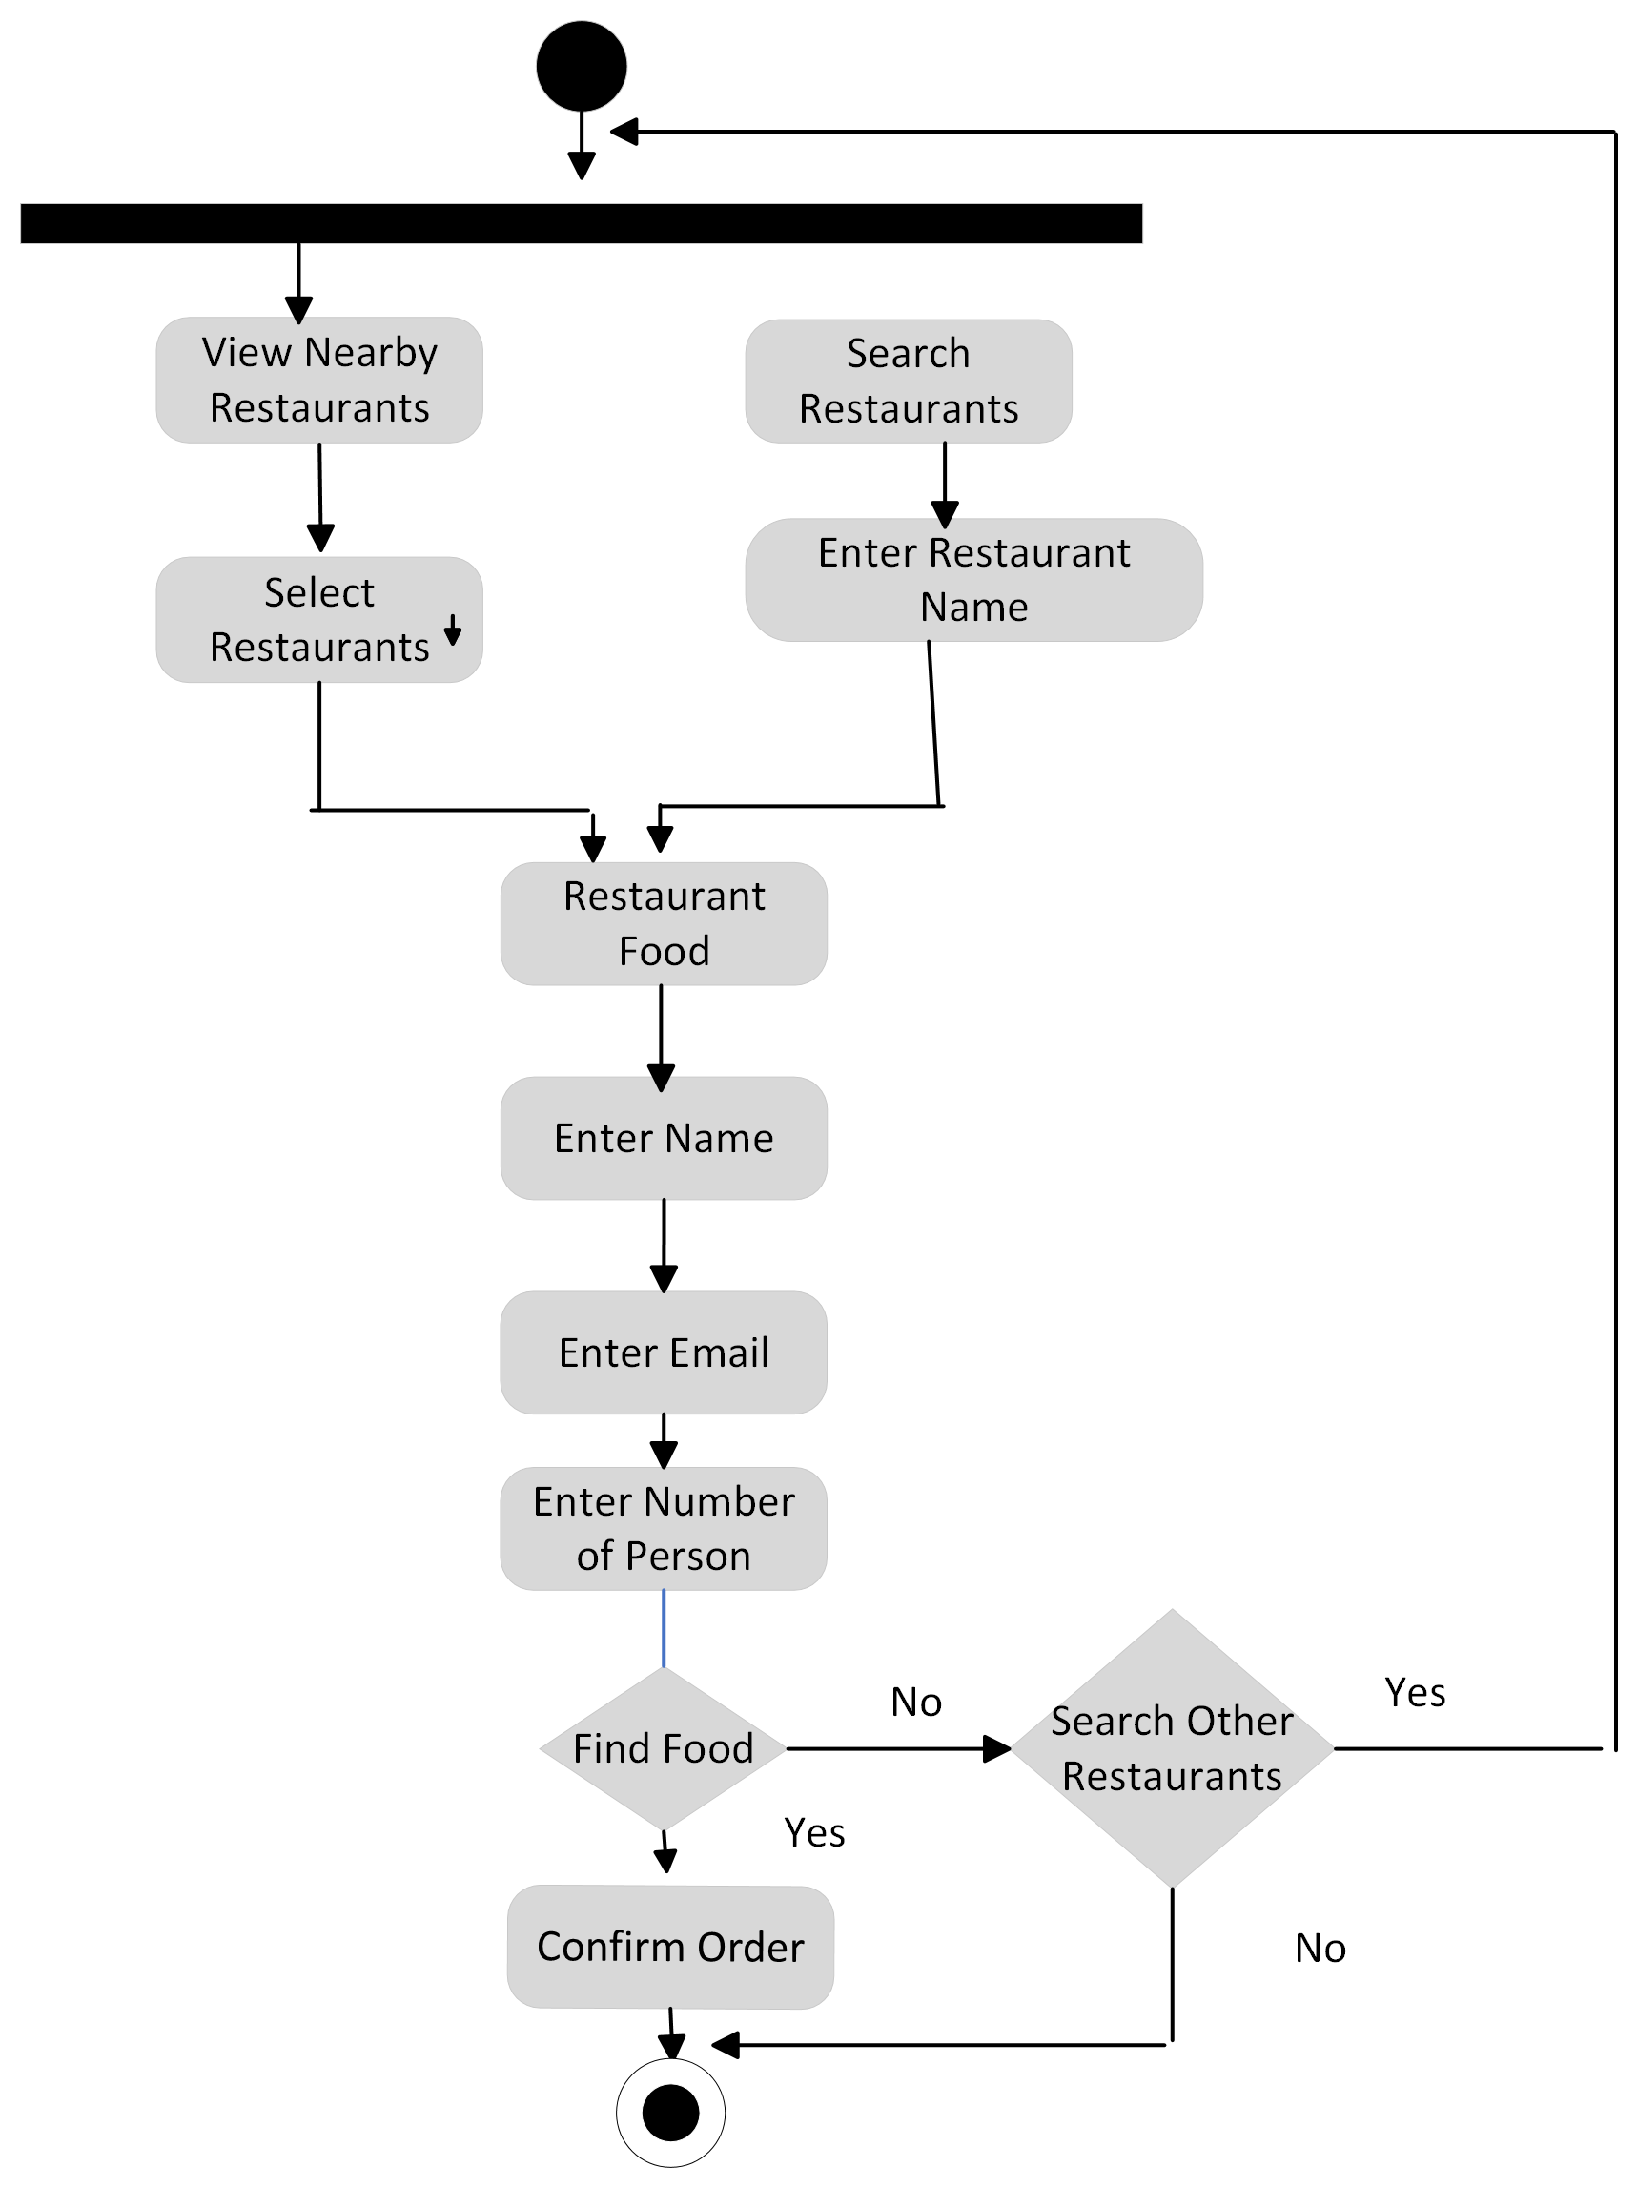
Activity Diagrams
Figure: Activity diagram of “Find Food”

Slide 47
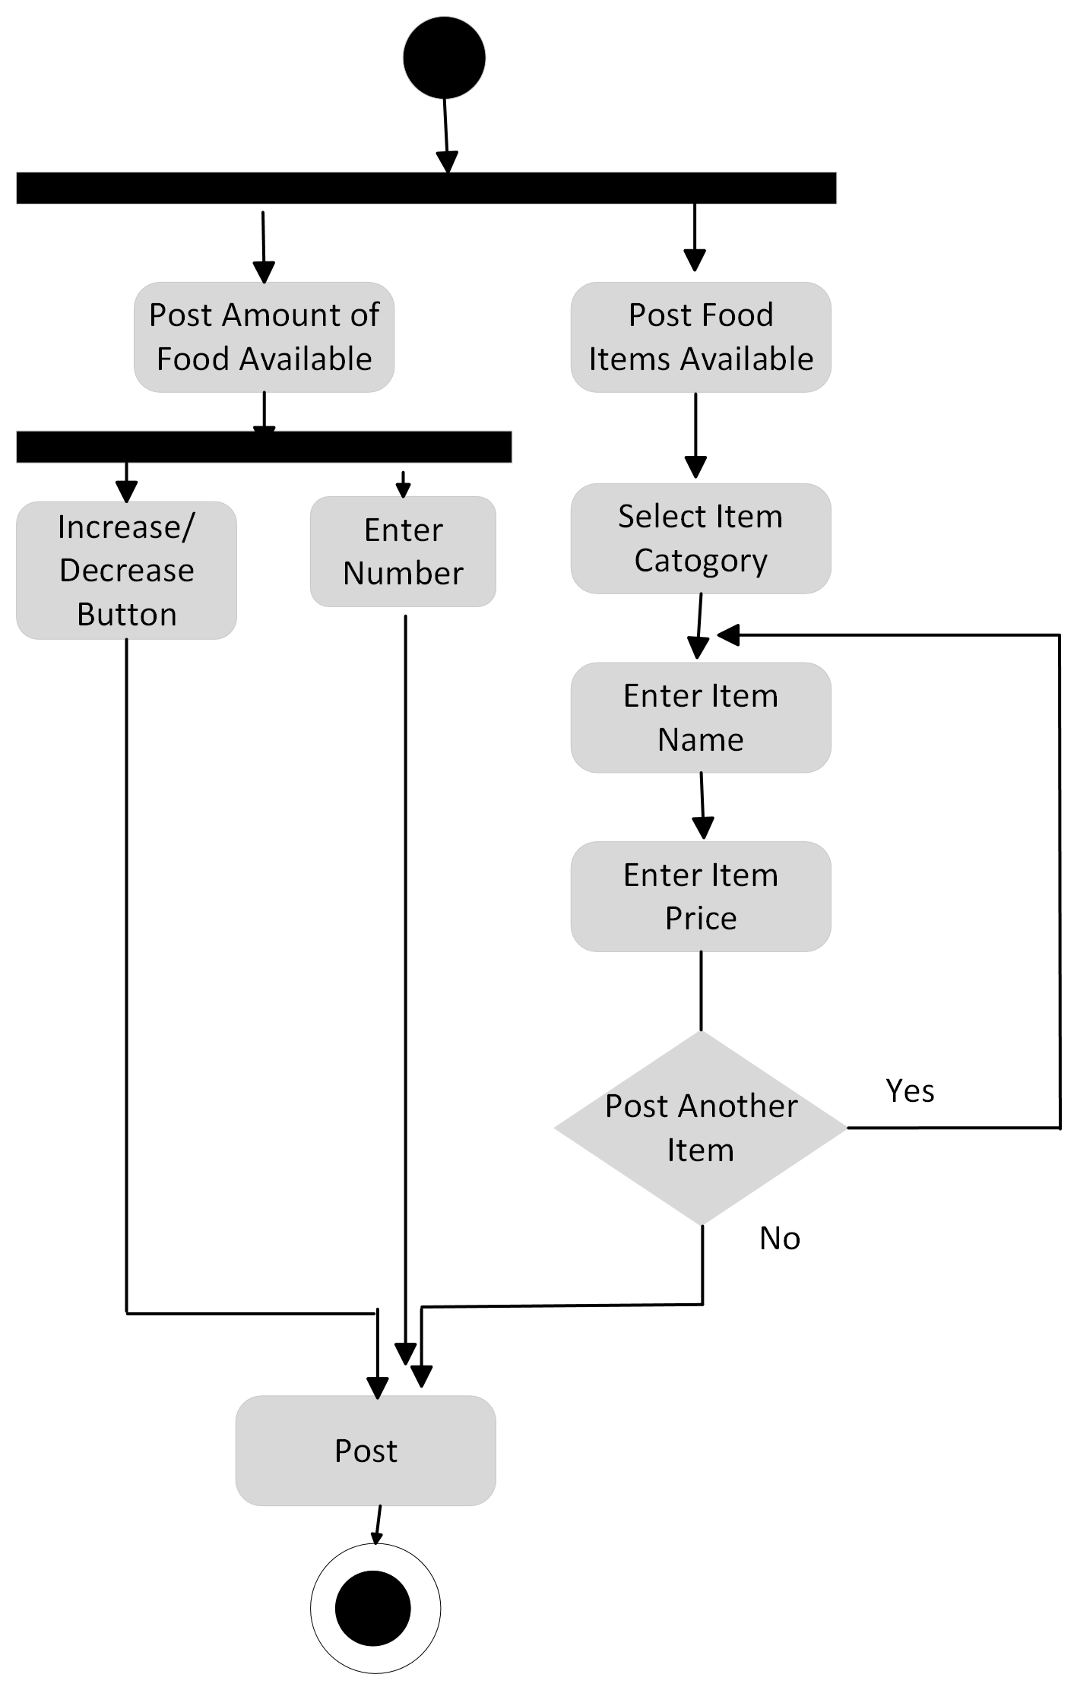
Activity Diagrams
Figure: Activity diagram of “Post Food”

Slide 48
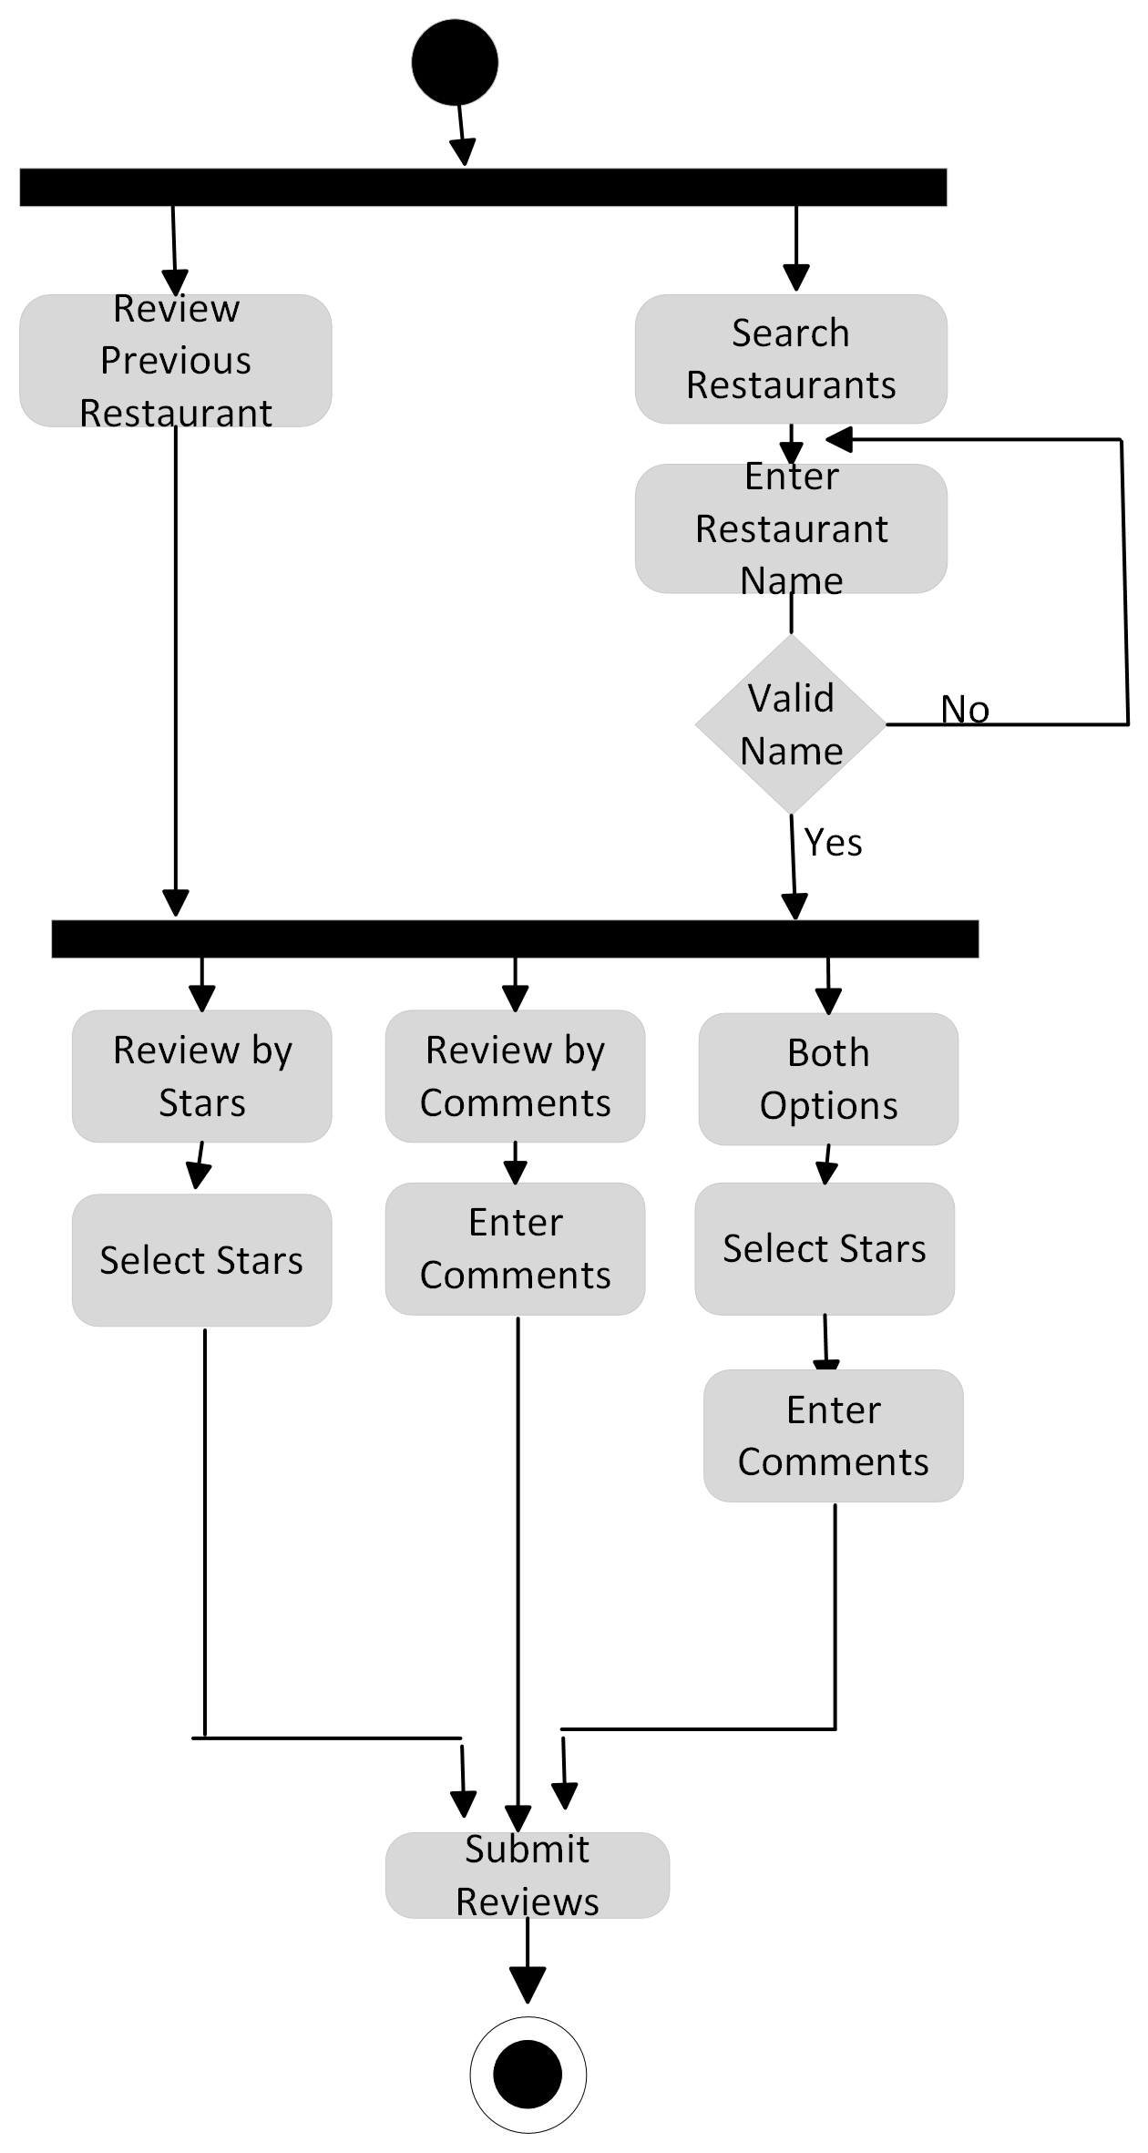
Activity Diagrams
Figure: Activity diagram of “Review”

Slide 49
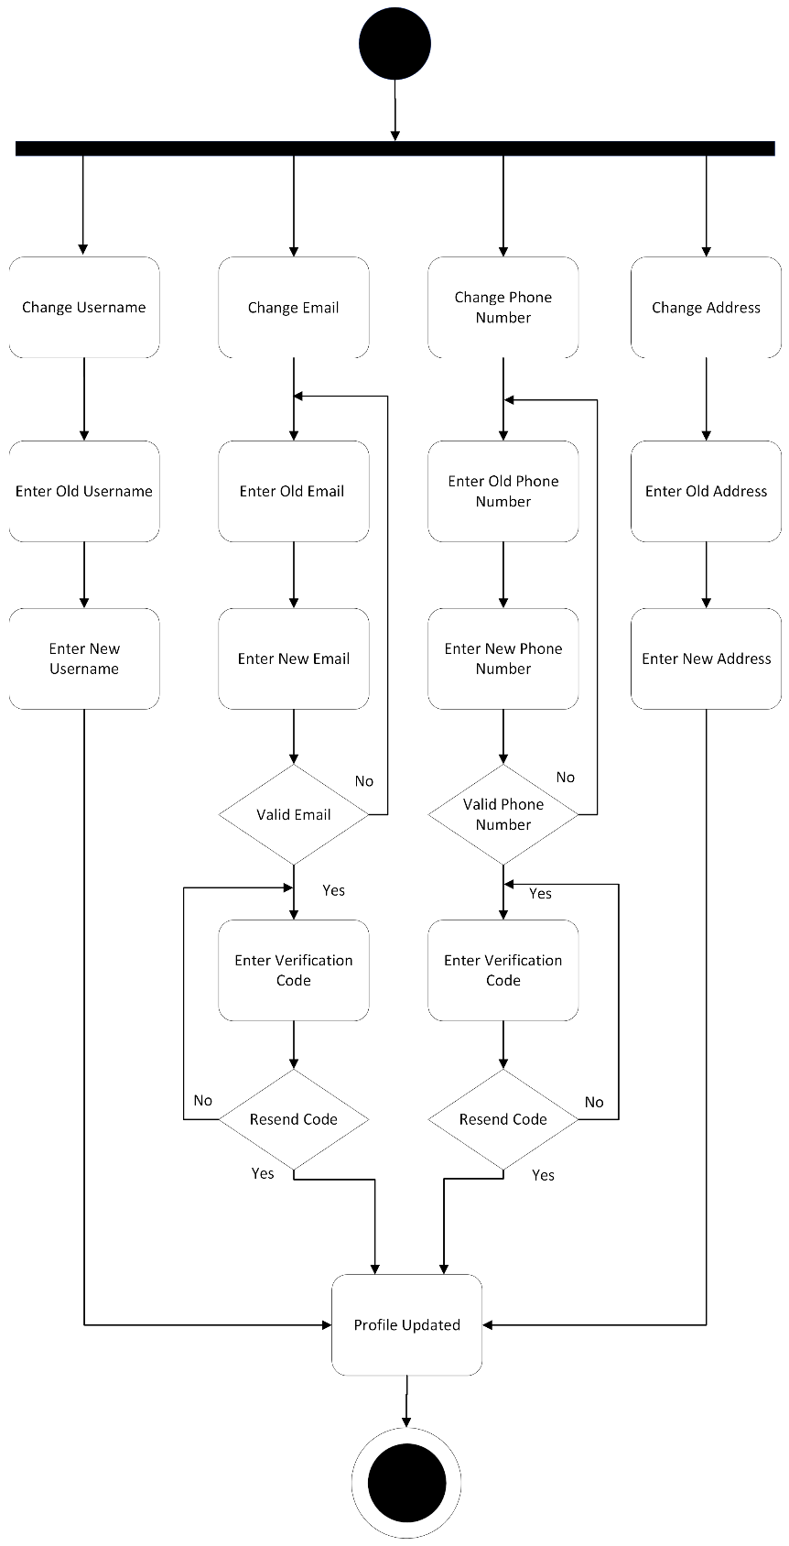
Activity Diagrams
Figure: Activity diagram of “Profile Management”

Slide 50
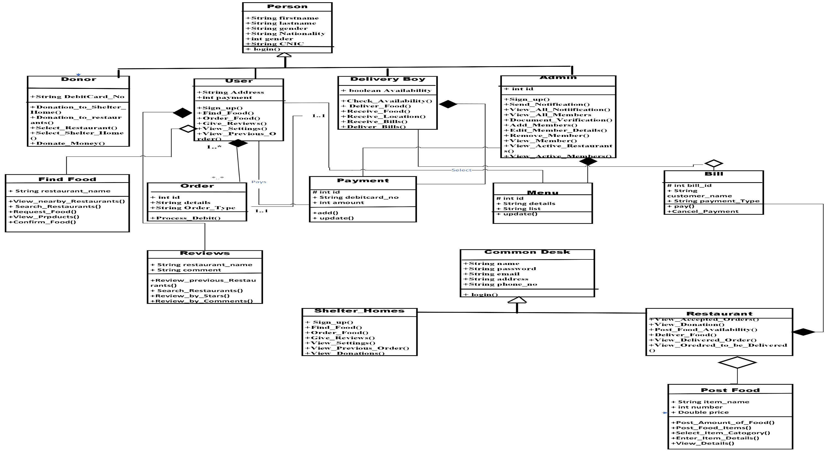
Class Diagram or Data Flow Diagrams
Figure: Class Diagram of “Save Food Stuff”

Slide 51
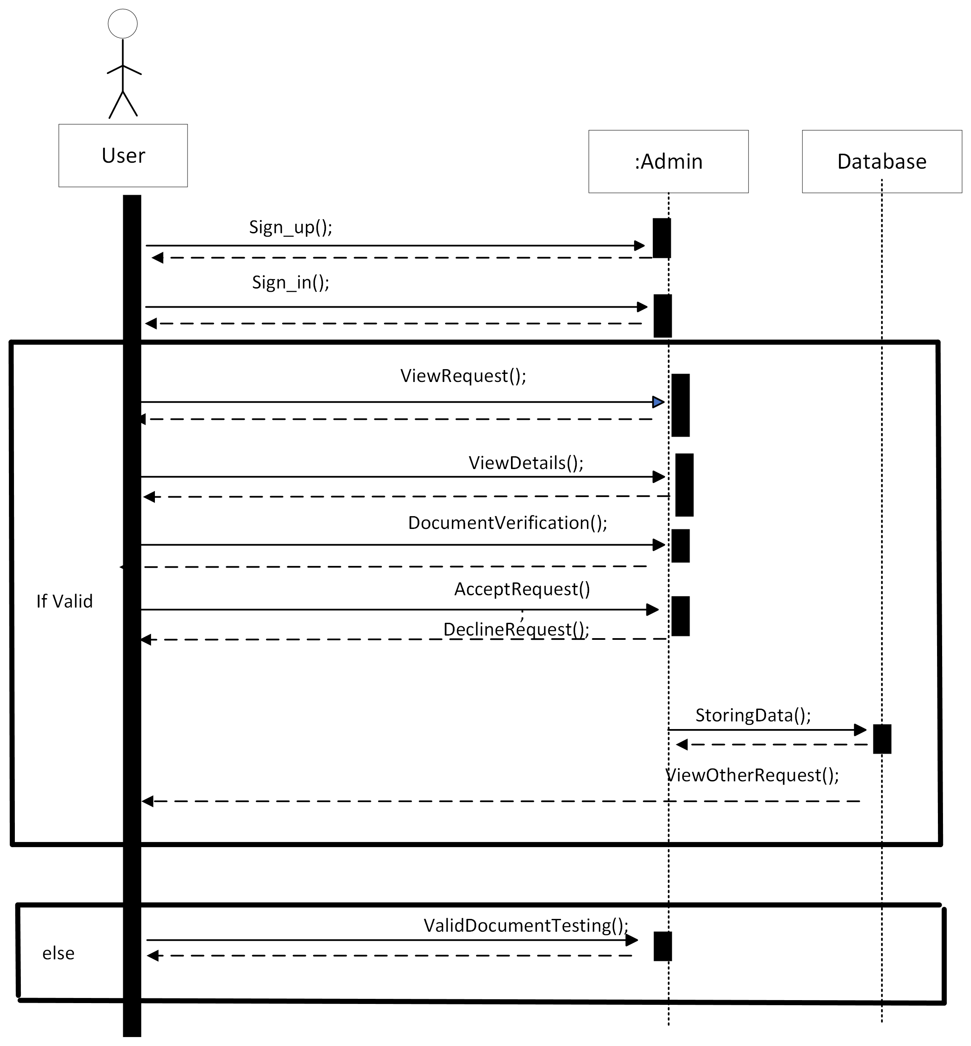
Sequence Diagram
Figure: Add Member Sequence Diagram

Slide 52
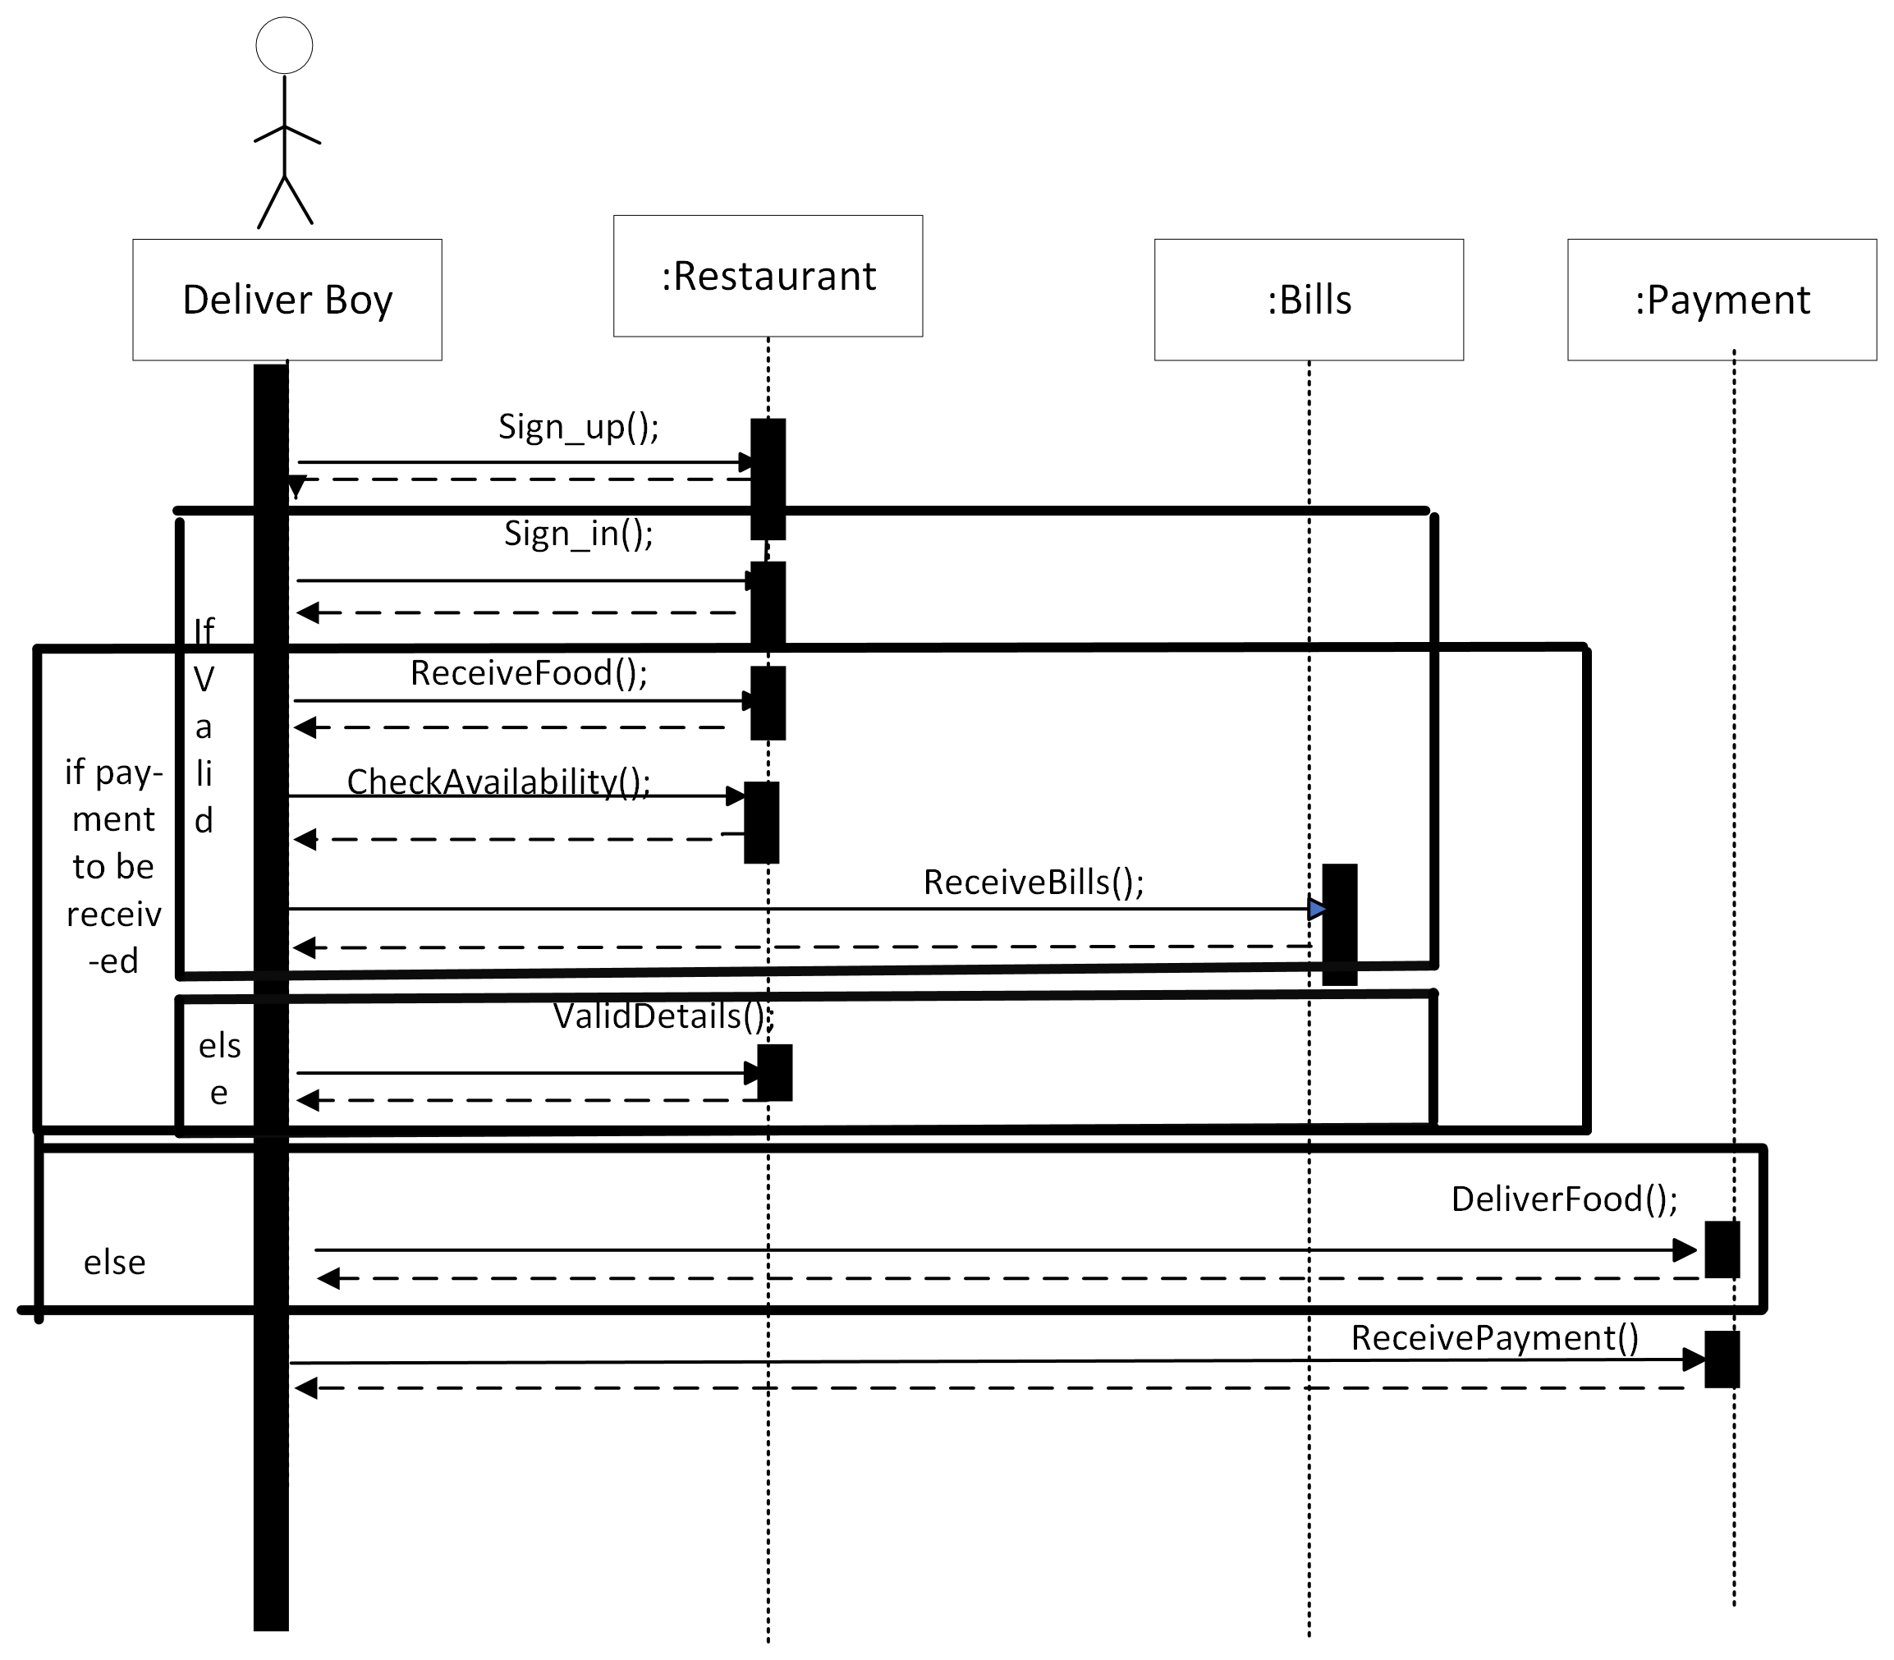
Sequence Diagram
Figure: Sequence Diagram of “Donation”

Slide 53
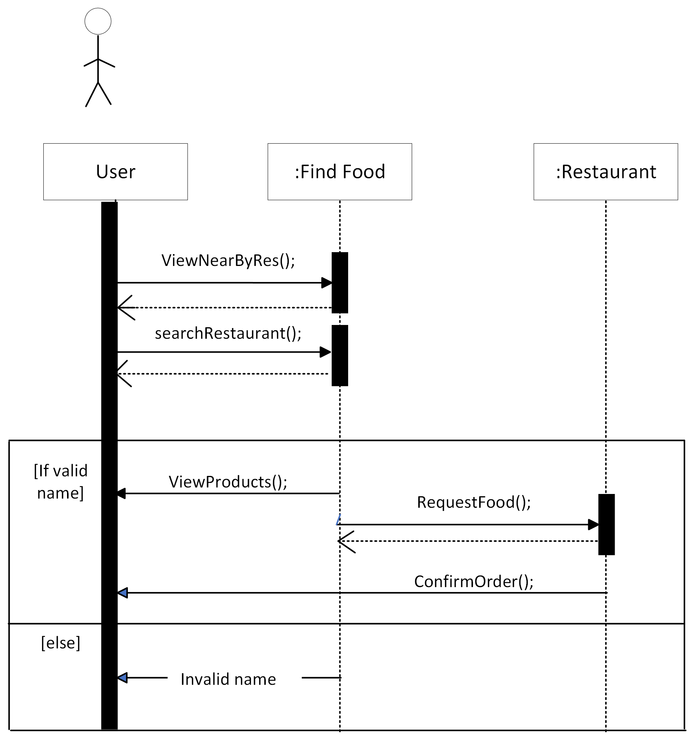
Sequence Diagram
Figure: Sequence Diagram of “Find Food”

Slide 54
Data Representation [User Schema ]
const monggose= require( 'mongoose' )
const UserSchema= monggose.Schema({
"Id":
{ description: "this is a unique id of a record",
type: "Number"
required: "true"
},
"Username"
{
"description": "A user's Username",
"type": "string",
required: "true"
},
"email"
{
"description": "user's email",
"type": "email",
required: "true"
},
"password"
{
"description": "User’s password",
"type": "password",
required: "true"
},
"Location"
{
"description": “user's location",
"type": "string",
required: "true"
}
“Mobile No”
{
"description": “user's mobile no",
"type": "string"
required: "true"
}
})
module. Exports= monggose.model ( "User " , UserSchema)

Slide 55
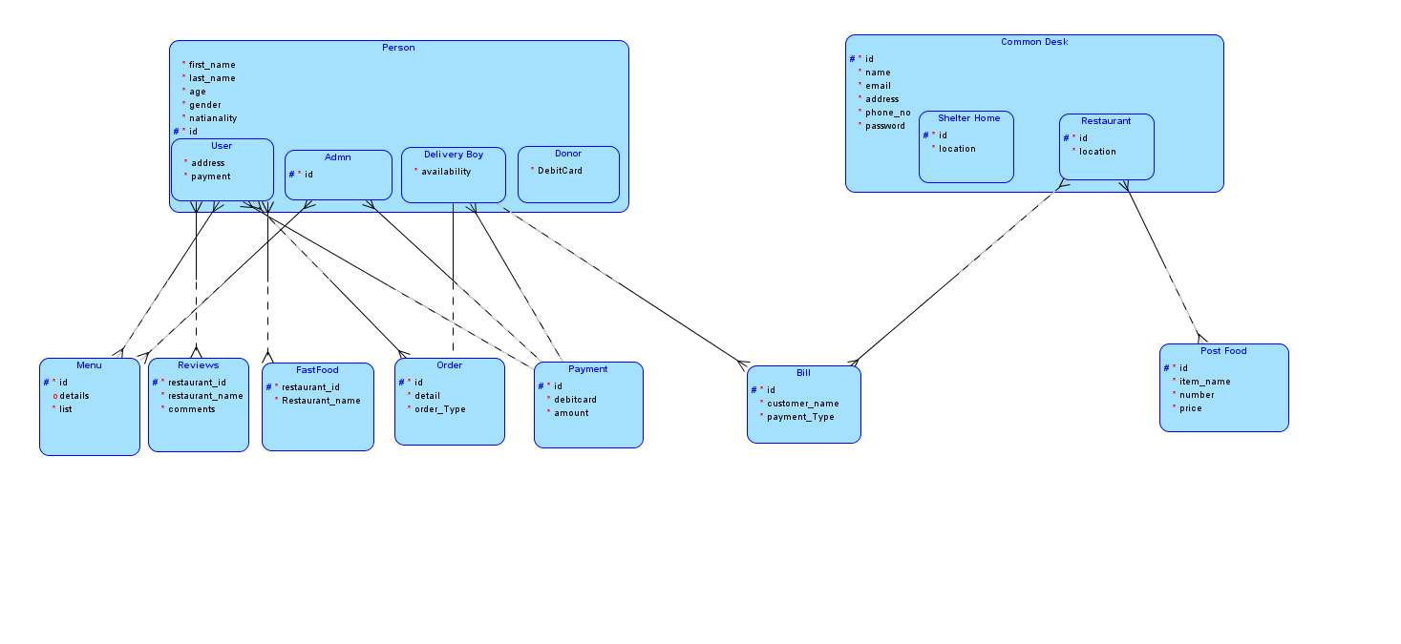
Entity Relationship Diagram

Slide 56
Algorithms

Slide 57
Algorithm User schema:
const monggose= require( 'mongoose' )
const UserSchema= monggose.Schema({
"Id":
{ description: "this is a unique id of a record",
type: "Number"
required: "true"
},
"Username"
{
"description": "A user's Username",
"type": "string",
required: "true"
},
"email"
{
"description": "user's email",
"type": "email",
required: "true"
},
"password"
{
"description": "User’s password",
"type": "password",
required: "true"
},
"Location"
{
"description": “user's location",
"type": "string",
required: "true"
}
“Mobile No”
{
"description": “user's mobile no",
"type": "string"
required: "true"
}
})
module. Exports= monggose.model ( "User " , UserSchema)

Slide 58
Algorithm Restaurant Schema:
const monggose= require( 'mongoose' )
const restaurantSchema= monggose.Schema({
"Id":
{ description: "this is a unique id of a record",
type: "Number"
required: "true"
},
"name"
{
"description": "A restaurant name",
"type": "string",
required: "true"
},
"email"
{
"description": "restaurant’s email",
"type": "email",
required: "true"
},
"password"
{
"description": "restaurant’s password",
"type": "password",
required: "true"
},
"address"
{
"description": “restaurant’s address ",
"type": "string",
required: "true"
}
“phoneNo”
{
"description": “restaurant's mobile no",
"type": "string"
required: "true"
}
})
module. Exports= monggose.model ( "Restaurant " , restaurantSche

Slide 59
Algorithm Reviews Schema:
const monggose= require( 'mongoose' )
const reviewsSchema= monggose.Schema({
"restaurantId":
{ description: "this is a unique id of restaurant to whom reviews are given",
type: "Number"
required: "true"
},
"restaurantName"
{
"description": "A restaurant name",
"type": "string",
required: "true"
},
"comments"
{
"description": "comment reviews given to restaurant",
"type": "string",
required: "true"
}

Slide 60
Algorithm Payment Schema:
const monggose= require( 'mongoose' )
const paymentSchema= monggose.Schema({
"Id":
{ description: "this is a unique id of a record",
type: "Number"
required: "true"
},
"debitCard"
{
"description": "debit card number through which payment is done",
"type": "string",
required: "true"
},
"amount"
{
"description": "the amount that is to be paid",
"type": "double",
required: "true"
}
})
module. Exports= monggose.model ( "Payment " , paymentSchema)

Slide 61
Implementation
Sign-in algorithm pseudo code:
Allows user to sign in to the system for further actions
Enter username
Enter password
Check if username correct
Check if password correct
Display message “Signed in successfully”

Slide 62
Implementation
2. Donation Algorithm pseudo code:
Allows user to donate to restaurants or shelter home
Donation to Restaurant
Select restaurant
Enter amount
Donate with credit card or debit card
Enter card number
Donation to shelter home
Select shelter home
Enter amount of food
Get location

Slide 63
Implementation
3. Reviews Algorithm pseudo code:
Allows user to give reviews to restaurants
Review previous restaurant
Search restaurant
Enter restaurant name
Select stars to give review
Enter comment to give review
Submit review

Slide 64
Implementation
4. Find Food Algorithm pseudo code:
Allows user to find and order food
View nearby restaurant
Select restaurant
Search restaurant
Enter restaurant name
Request food
Enter name
Enter email
Enter no. of persons
If food available
Order for free
Pay 10%
Pay 15%
Pay with debit card or COD
Enter card number
Confirm order

Slide 65
Implementation
5. Admin Algorithm pseudo code:
Allows admin to add new members.
Required Sign in
View all incoming requests
View the details of each request
Testing the documents for verification.
Monthly Expenses Records
Income Certificate
Accept user request if it is needy.
Decline request in case of wrong documents.
Store all the data in database using Sql/Mongo DB language.
Confirmation message send to user.

Slide 66
Implementation
6. User Algorithm pseudo code:
Allow User to Order food from restaurants.
Required User Sign in.
To order food user press Find Food button.
All available nearby restaurants will display.
User can also search it by name.
Payment can be paid by hand or by debit card according to user choice.
Go to setting to modify any profile data.
Press pre Order Buttons to view previous orders.
On receiving ordered food bill will paid to delivery boy.

Slide 67
Implementation
7. Delivery Algorithm pseudo code:
Allow Delivery boy to deliver food from restaurants.
On placing the order food request is reached delivery boy .
On requesting the check delivery boy’s availability first.
If delivery boy is available he accepts the offer.
Food will be delivered on required location.
Bill will be received after food is received by the user.
Delivery charges will paid according to user’s choice.
No charges.
10% charges of total payment.
15% charges of total payment.

Slide 68
Implementation
8. Restaurant Algorithm pseudo code:
Allow restaurants to transfer food to needy people.
On this site restaurants add specific amount of food per person.
By visiting restaurants user can easily viewed their profile.
It will serve Food on FIFO operation.
User have to register him first.
Go to find food Button.
List of restaurants appeared that offering food.
Ordered food will be delivered on required location in minimum time

Slide 69
User Interfaces
Interface-1: Front Screen Of application

Slide 70
User Interfaces
Interface-2: Main Screen Of application

Slide 71
User Interfaces
Interface-3: Find Food

Slide 72
Testing

Slide 73
Testing Methodology
We have implemented white box testing because in this type experts are involved.

Slide 74
Lesson Learnt
FA20-BCS-027: During the whole semester I have learnt a lot about the SDLC. I learnt all the documentation need during the development process of new system. It also includes the implementations of modules using different languages. In short this course teaches me how to integrate a large project along its testing phases which is also very beneficial during my FYP .
FA20-BCS-029:I learnt how to design a system and all the steps involved. Moreover, the concept of all the components of a system and how to integrate these components was also grasped. In addition, how to use process models, how to test the system, how to implement software engineering concepts and their importance in software development was also learnt.

Slide 75
Work Break Down
Note: 1 Slide only
Write each team member work done in whole project.
Each member will write his/her own work done.

Slide 76
Conclusion
To conclude, our app is specifically designed to minimize food wastage and feeding the hunger. It solves the issue of distribution of food that usually goes into waste. We try to make sure that this food is only delivered to those who actually need it.
The app is designed in two ways, the user who is donating the food and the person/organization that is claiming the food.

Slide 77
References
https://app.uizard.io/prototypes/rgLp11mKjnuVKgg9zBj5
https://pern-my.sharepoint.com/:u:/r/personal/fa20-bcs-029_isbstudent_comsats_edu_pk/_layouts/15/Doc.aspx?sourcedoc=%7B02241a2e-caa7-41b4-a398-39e8c9f346f1%7D&action=edit&or=PrevEdit&cid=c241ae5f-c708-4f2a-9154-c206132fea4e

Slide 78
Plaragism Report
Note: 1 Slide only
Attach the Plaragism report of your project scope document from library staff of turnitin tool (http://turnitin.com)

Slide 79
Demonstration
Demonstration of One Major Module implementation of Proposed Project.

Slide 80

Questions and Answers

